Slide 1
QNN and QML
Presentation-1

Slide 2
Quantum ML and NN
Given paper topics:
Quantum neural networks by Alexandr A. Ezhov and Dan Ventura.
High-precision quantum algorithms for partial differential equations by Andrew M. Childs, Jin-Peng Liu, Aaron Ostrander.
Training deep quantum neural networks by Kerstin Beer , Dmytro Bondarenko , Terry Farrelly, Tobias J. Osborne,, Robert Salzmann, Daniel Scheiermann & Ramona Wolf.
Quantum Neural Network States: A Brief Review of Methods and Applications by Zhihahn Jia, Biao Yi,Rui Zhai, Yu-Chun Wu, Guang-Can Guo and Guo-Ping Guo.

Slide 3
Quantum ML
Quantum Kernel Alignments
Quantum Support Vector Machines and classifications.
Training Parameterized Quantum Circuits (SPSA,QN-SPSA,Vanilla GD,Quantum GD).
Making variational quantum classifiers.
Noise effects in these parameterized quantum circuits.

Slide 4
Quantum NN
Training deep quantum neural networks.
QNN.
Quantum Neural Network States: A Brief Review of Methods and Applications.
Quantum neural networks--A theoretical overview.
High-precision quantum algorithms for partial differential equations.

Slide 5
Classical part description in QML and QNN
Classical Kernels.
Different kinds of CNN/ANN Networks.
Classical kernel alignments in Classical neural networks.
Classical SVMs.
Described a short overview in below slides…..

Slide 6
CLASSICAL NEURAL NETWORKS
A multi-layer artificial neural networks, is modelled like the human brain, with multi-layered perceptrons, activation function and learning mechanism or optimiser like feedforward and backpropagation algorithms.
Major Disadvantage :-
Hardware dependence on processor with parallel processing powers.
ML training algorithms are computationally expensive . With faltering Moore’s law, there’ll be slower rate of advance in future. Classical computations have thermodynamic limitations.
Appropriate network structure comes from trial and error, i.e. no proper model structure.

Slide 7
Perceptron and Logistic neural network - learning process difficult as activation function isn’t continuous and small change in weight may change the output ; gradient descent applied to algo. Feedforward NN works well to approximate quantum states.
Convolution Neural Network - used mainly in classification and image recognition. Consists a convolution layer, pooling layer connected to previous layers NN. Disadv :- CNN do not encode the position and orientation of object. Lack of ability to be spatially invariant to the input data
Boltzmann Machine - a stochastic recurrent neural network.
Recurrent Neural Network - uses sequential and time series data. The output of recurrent neural networks depend on the prior elements within the sequence. Disavd : gradient vanishing, can’t process long sequence using RELU or tanh.

Slide 8
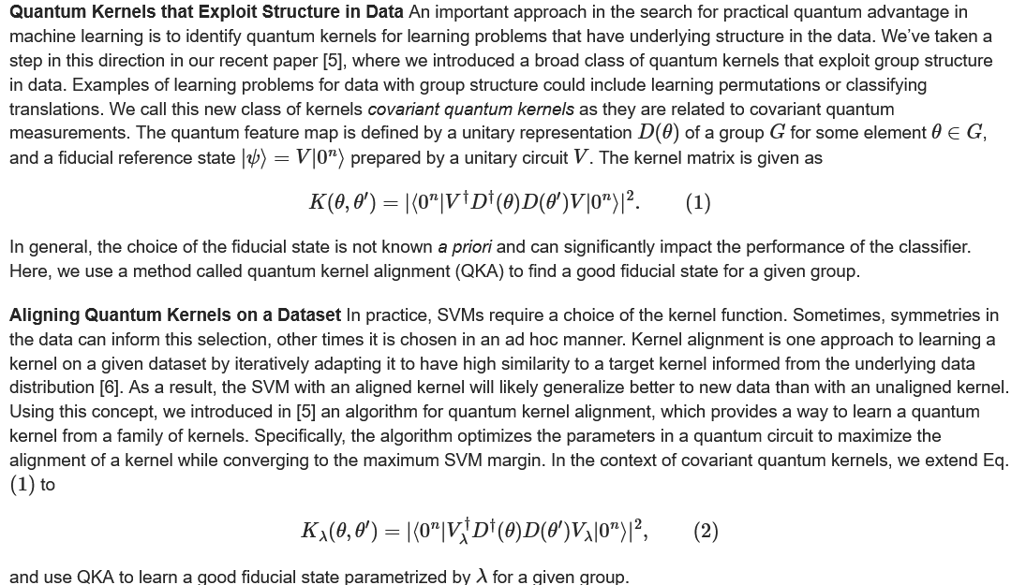
Quantum ML
QUANTUM KERNEL ALIGNMENT/Q-SVM: (Quantum Kernels )Quantum computers can be used to encode classical data in a quantum-enhanced feature space. In 2019, IBM introduced an algorithm called the quantum kernel estimator (QKE) for computing quantum kernels. This algorithm uses quantum circuits with data provided classically and offers an efficient way to evaluate inner products between data in a quantum feature space. For two data samples 𝛳 and 𝛳’ the kernel matrix is given as-
In Quantum Machine Learning (QML), Quantum kernel is the approach of exploiting group structure in data which helps to achieve quantum speedup. Quantum kernels can be optimized with a technique called kernel alignment.
QNN/QLSTM are parameterized quantum circuits which acts like linear methods in quantum feature space and suitable case for using quantum kernels and in turn can be optimized using Quantum Kernel Alignment.

Slide 9
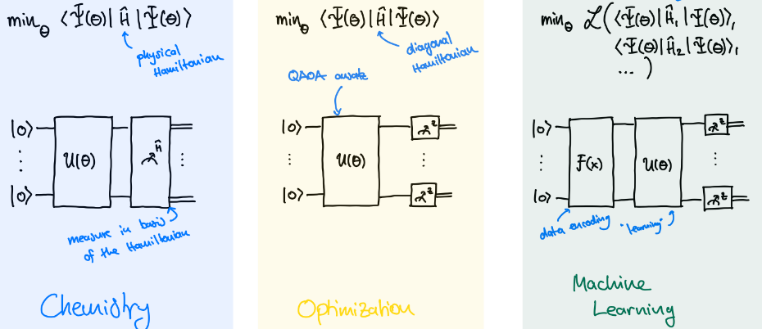
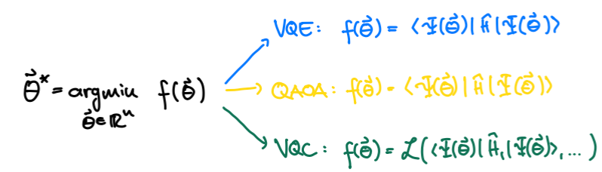
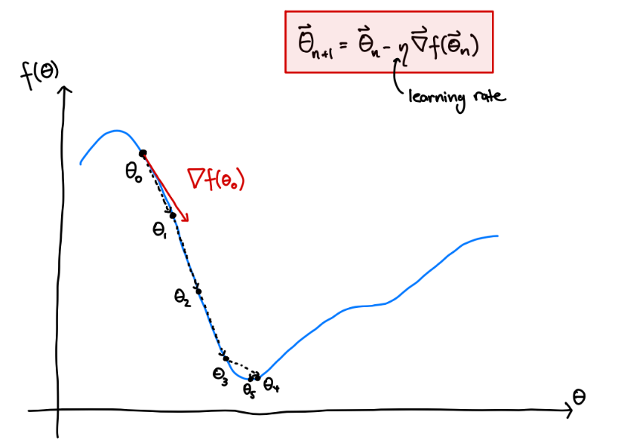
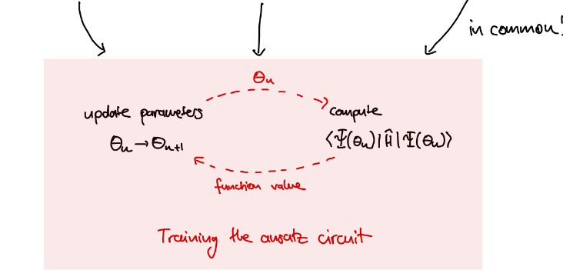
TRAINING PARAMETERIZED QUANTUM CIRCUITS/MAKING VARIATIONAL QUANTUM CLASSIFIERS :
OUR TASK:
2. GRADIENTS:

Slide 10
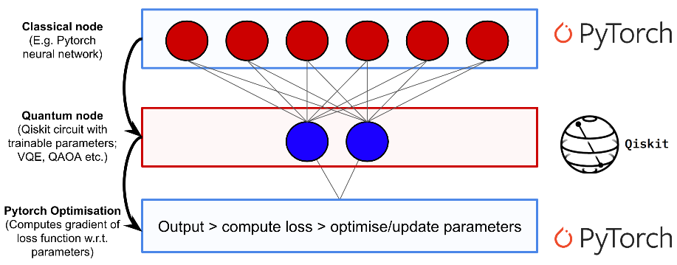
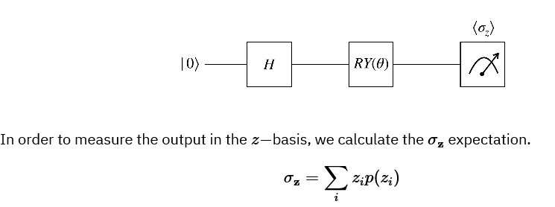
Quantum NN
Load data
Create a quantum circuit
Create a "Quantum-Classical Class" with PyTorch
Data processing
Creating the Hybrid Neural Network
Train the network and get results.

Slide 11
THANK YOU

